Slide 1


, , , and what we can do with them
Claire Boyd
Data Scientist
NYC Department of Finance, Property Modeling & Valuation
boydclaire@finance.nyc.gov

Slide 2


A little about me
Native New Yorker
Researcher at Urban Institute for 5 years
Studied Computer Science and Public Policy at UChicago
Worked at Cook County Assessors Office and Mansueto Institute for Urban Innovation, applying data science in the property assessment space
Now at a Data Scientist for DOF – I’m excited about using and building open-source tools to enhance the work we do for the City of New York

Slide 3
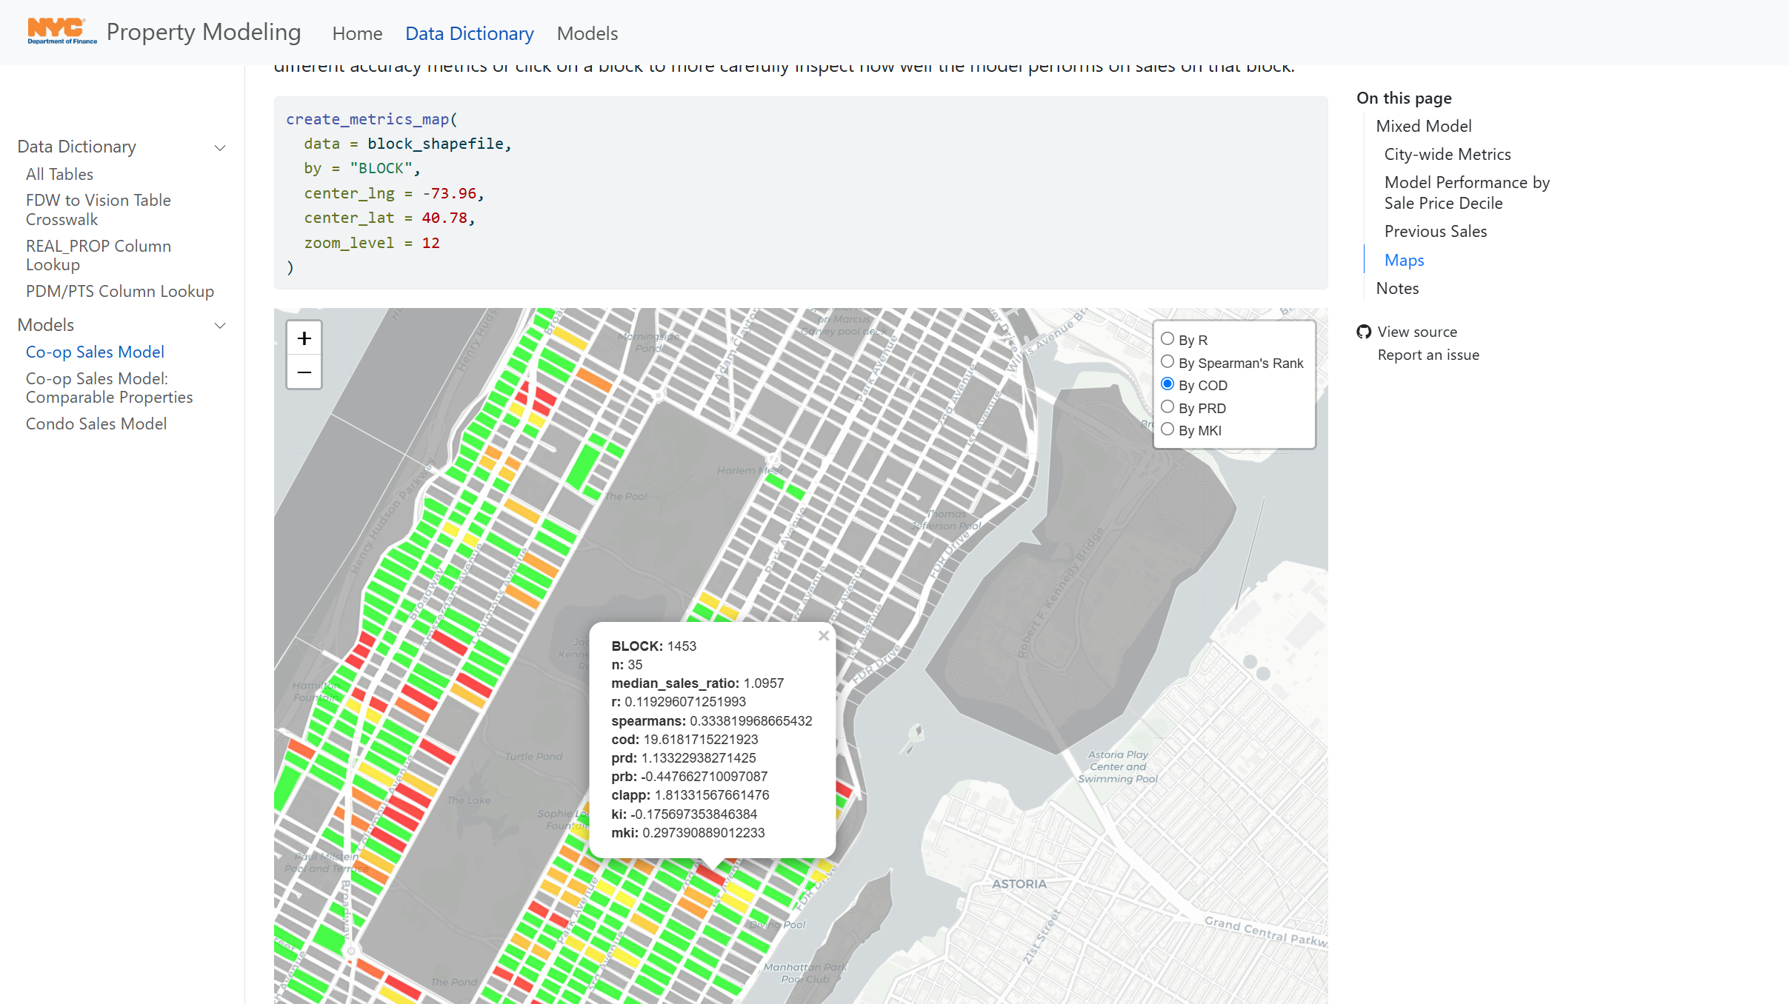

Slide 4
Imagine this.

Slide 5
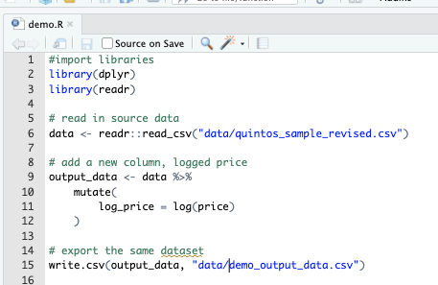
My coworker Ethan and I are tasked to work on a project demo.R. The goal is to add a few more columns to an existing csv (logged price, logged estimate, price-estimate, log_price-log_estimate).
In the current ecosystem:
How could I work on this task so that my work was version controlled (saved regularly and sequentially)?
How could I collaborate with Ethan on this in real time?
How could we combine our work when it was finished, assuming someone else might want to repeat this process another time?
Where would we store the finished product so that our team knew it was the final version and future data analysts might be able to replicate our work easily?
Notes:
What problems might come up along the way?
If using the same file:
Not being able to edit the same script at once
If using different file copies:
Forgetting chunks of code when copying and pasting into one version
Calling variables different names
Importing different packages
Multiple files with the same name, but different versions

Slide 6
My coworker Ethan and I are tasked to work on a project demo.R. The goal is to add a few more columns to an existing csv (logged price, logged estimate, price-estimate, log_price-log_estimate).
In the current ecosystem:
How could I work on this task so that my work was version controlled (saved regularly and sequentially)?
How could I collaborate with Ethan on this in real time?
How could we combine our work when it was finished, assuming someone else might want to repeat this process another time?
Where would we store the finished product so that our team knew it was the final version and future data analysts might be able to replicate our work easily?
Current system | Problems or potential risks
Save different named versions of the same script | Which version is the most up to date? How do we revert changes of scripts if we make a mistake?
Work on different scripts and talk to each other | Relies on really good communication to work seamlessly Repetitive work – could do the same portion of the project without realizing it
Copy and paste | Different changes to the same code – how to reconcile? Potential for repetitive code and take additional time to make sure it can run seamlessly
G Drive | Should we have a new 2025 folder? Where should it live in the G Drive? Would a new hire easily know where to look for this information?
Notes:
What problems might come up along the way?
If using the same file:
Not being able to edit the same script at once
If using different file copies:
Forgetting chunks of code when copying and pasting into one version
Calling variables different names
Importing different packages
Multiple files with the same name, but different versions

Slide 7
Enter .

Slide 8
git
git is like Word’s Version History for code.
It is a version control system that keeps track of all changes made in a folder (repository/repo)
A historical backup of “snapshots” of your work
Think of it as a “Save As” version
git can track branches, or different versions of the same folder locally, so you can try out two different things at one (e.g. master vs. feature-branch)
It is natively a command line interface (CLI) tool

Slide 9
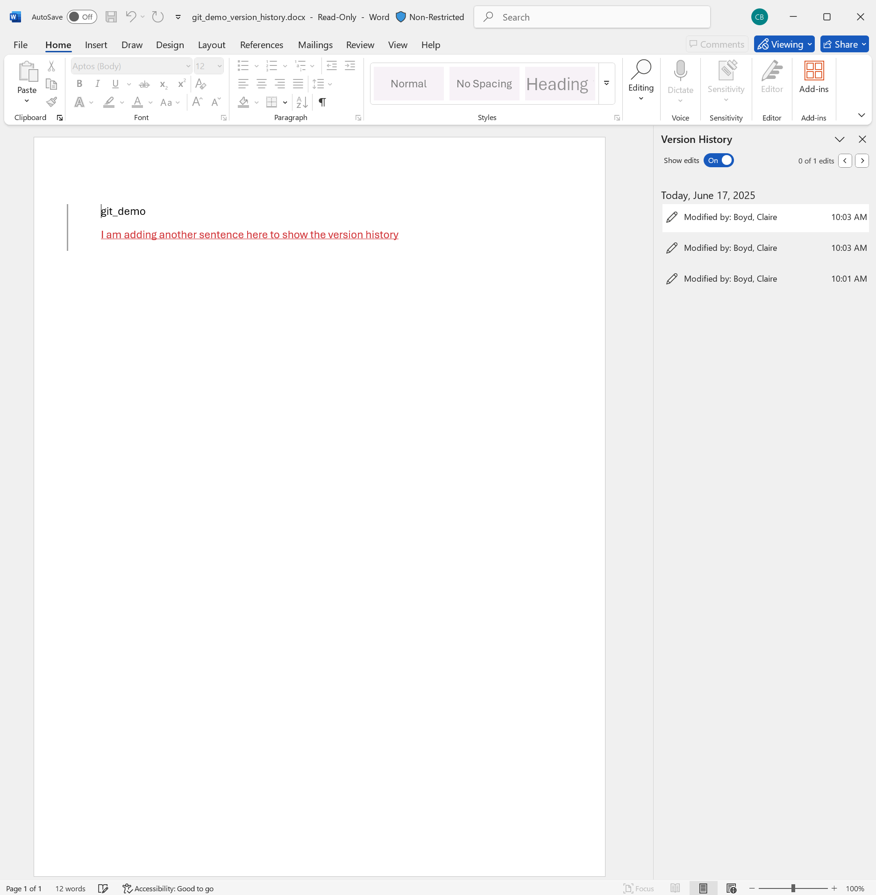
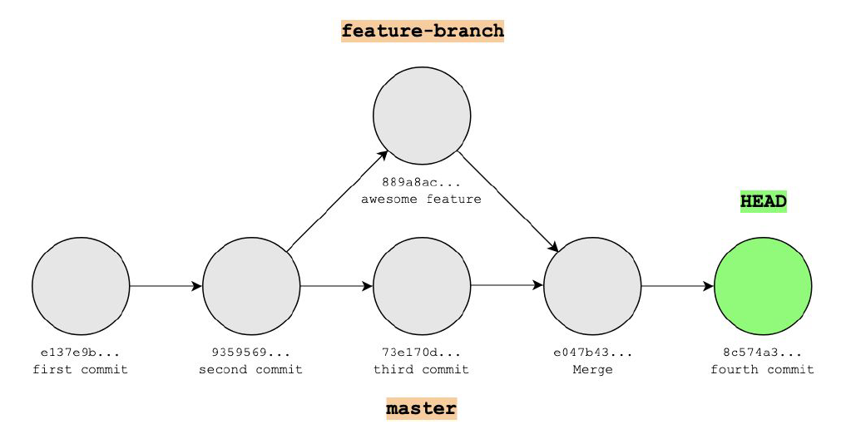
git
git is like Word’s Version History for code.
It is a version control system that keeps track of all changes made in a folder (repository/repo)
A historical backup of “snapshots” of your work
Think of it as a “Save As” version
git can track branches, or different versions of the same folder locally, so you can try out two different things at one (e.g. master vs. feature-branch)
It is natively a command line interface (CLI) tool
git saves a stream of snapshots (called commits)

Slide 10
git
git is like Word’s Version History for code.
It is a version control system that keeps track of all changes made in a folder (repository/repo)
A historical backup of “snapshots” of your work
Think of it as a “Save As” version
git (on it’s own) only keeps track of work on your local machine
git saves a stream of snapshots (called commits)

Slide 11
My coworker Ethan and I are tasked to work on a project demo.R. The goal is to add a few more columns to an existing csv (logged price, logged estimate, price-estimate, log_price-log_estimate).
In the current ecosystem:
How could I work on this task so that my work was version controlled (saved regularly and sequentially)?
How could I collaborate with Ethan on this in real time?
How could we combine our work when it was finished, assuming someone else might want to repeat this process another time?
Where would we store the finished product so that our team knew it was the final version and future data analysts might be able to replicate our work easily?

Slide 12
Enter .

Slide 13
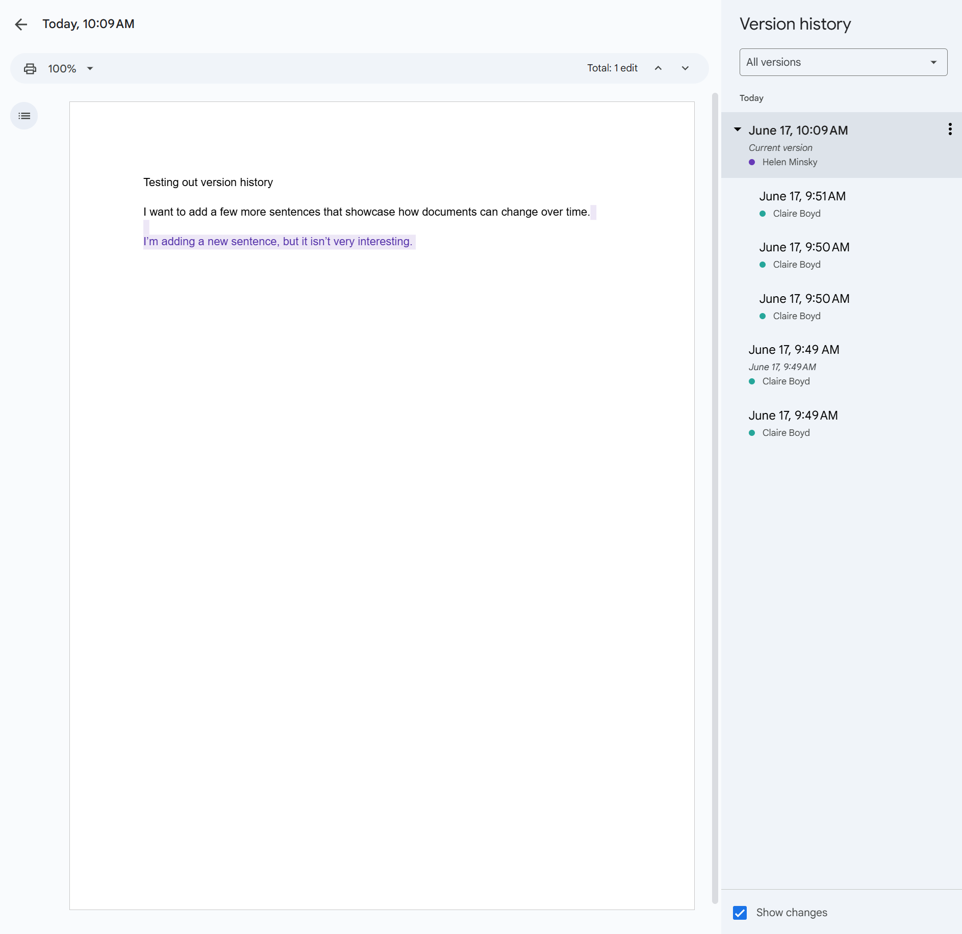
GitHub
When you use git/GitHub together, it is like GoogleDocs for code.
GitHub is a website that hosts repositories (folders) under version control by git.
It is the remote (cloud) storage for repositories (folders) that allows us to work together on the same material.
It allows for team development
Different versions of the project (these “snapshots”) can be merged together to create one final version
Allows for simultaneous work

Slide 14
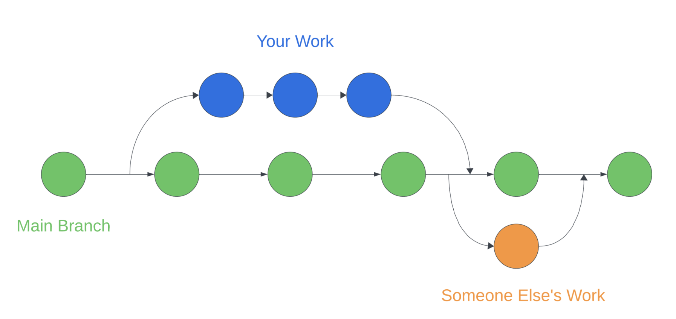
GitHub
Working alone
When you use git/GitHub together, it is like GoogleDocs for code.
GitHub is a website that hosts repositories (folders) under version control by git.
It is the remote (cloud) storage for repositories (folders) that allows us to work together on the same material.
It allows for team development
Different versions of the project (these “snapshots”) can be merged together to create one final version
Allows for simultaneous work
Collaborating with others

Slide 15
90% of Fortune 500 Companies use GitHub
GitHub is used by over 4 million organizations, and more than 100 million developers
1.5% percent of internet users use GitHub
In 2022, there were 3.5 billion contributions to GitHub projects, 20% were made to public repositories (project folders) the rest to private repositories.
Using this tool is industry standard for all data science and software teams.

Slide 16
My coworker Ethan and I are tasked to work on a project demo.R. The goal is to add a few more columns to an existing csv (logged price, logged estimate, price-estimate, log_price-log_estimate).
In the current ecosystem:
How could I work on this task so that my work was version controlled (saved regularly and sequentially)?
How could I collaborate with Ethan on this in real time?
How could we combine our work when it was finished, assuming someone else might want to repeat this process another time?
Where would we store the finished product so that our team knew it was the final version and future data analysts might be able to replicate our work easily?

Slide 17

GitHub Organizations @

Slide 18
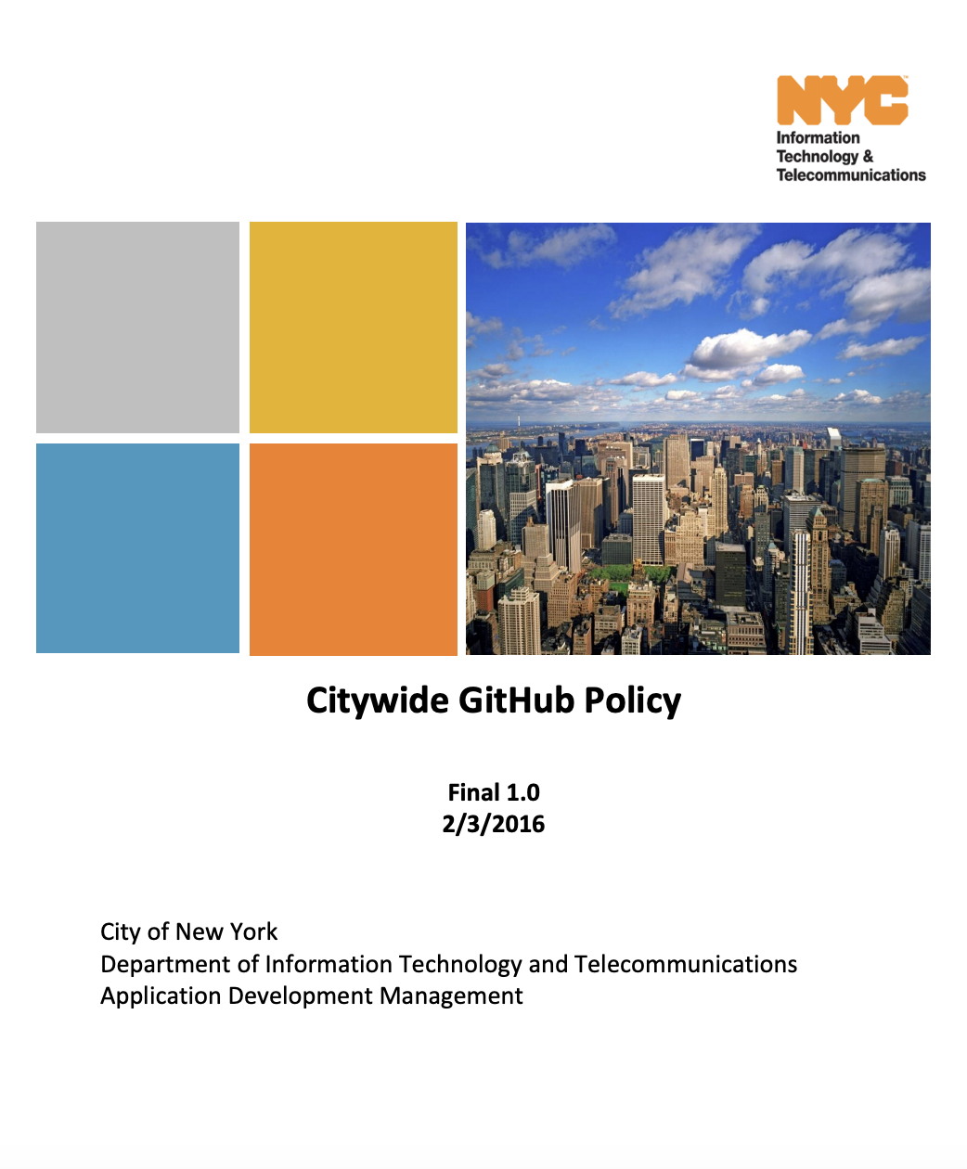
Citywide GitHub Policy (OTI, 2016)
2.3.2. A City agency may set up its own agency organizational account on GitHub, provided it takes full responsibility for the management and expense of that account and it complies fully with this Citywide policy. Agencies hosting their own repositories must do so using this single, top-level organization account. In other words, all of an agency’s GitHub projects should be in the agency’s one, official account.
2.4 The internal use of GitHub’s private repositories may be used only within City government: within a City agency or between City agencies, including authorized consultants, collaborating on a technology project. The internal use of GitHub aims to leverage the collaborative benefits and workflow efficiencies that the platform offers.

Slide 19
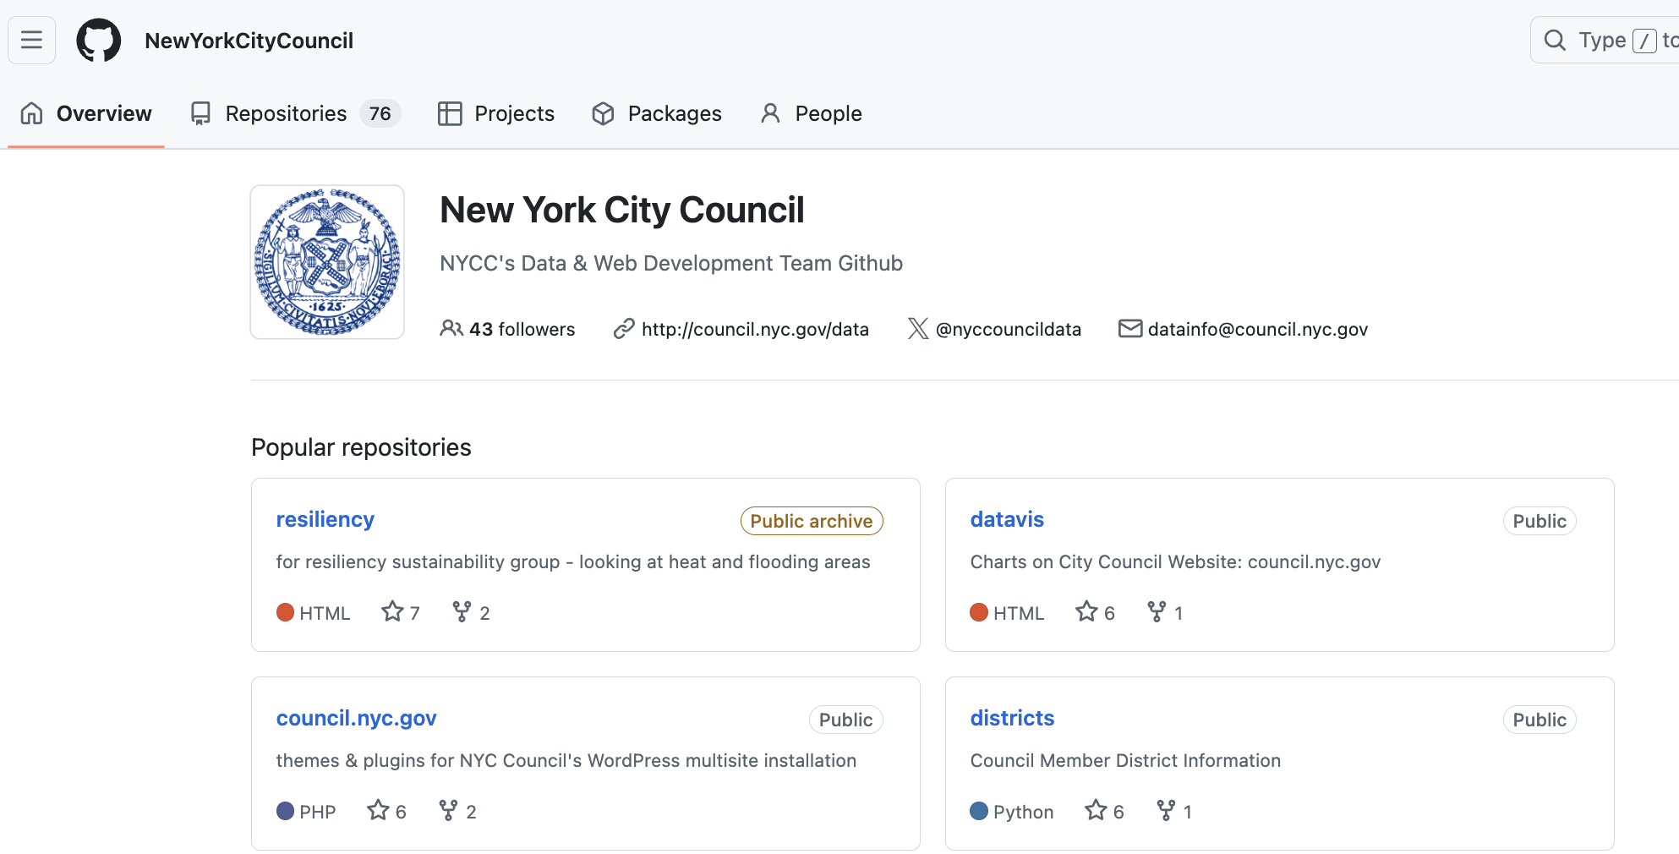
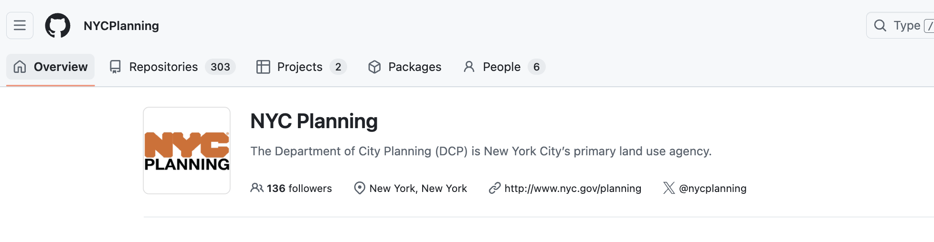
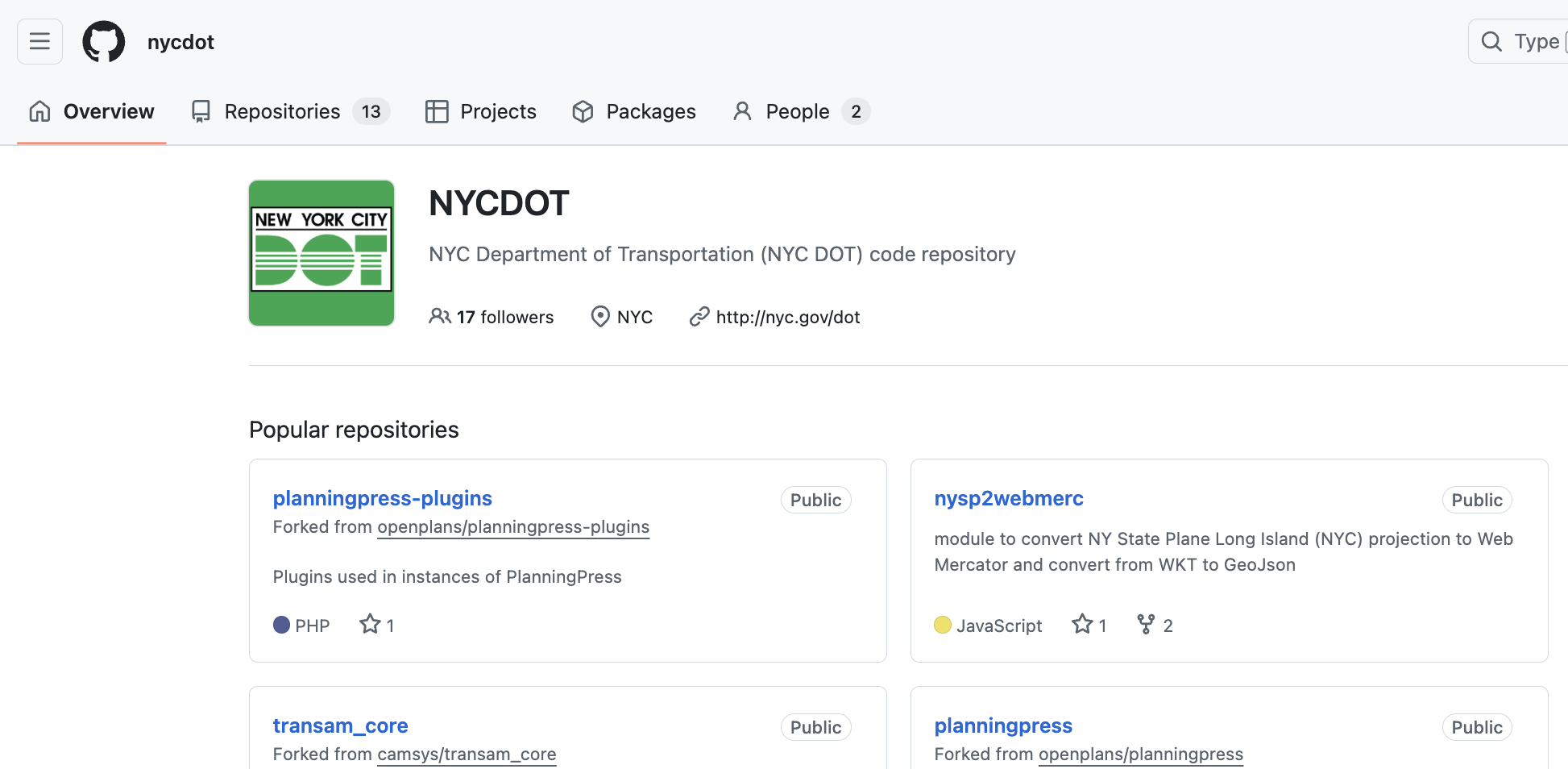
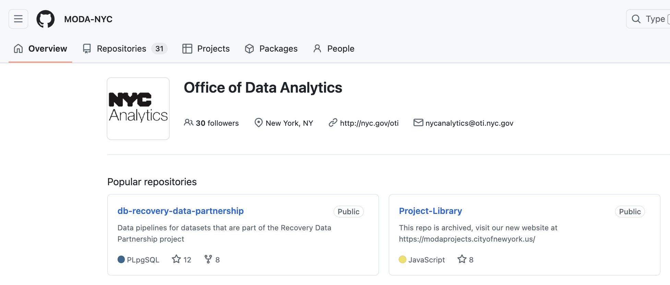
NYC agencies are actively using GitHub to streamline their work
There are 85+ GitHub organizations that have admin emails that end in .nyc.gov

Slide 20
OTI is working on making it easier to use Git/GitHub
The Data Analytics team at OTI has recently claimed ownership of the GitHub Enterprise (paid) account for the city, which currently has ~2,000 available licenses. They are making a concerted effort to get agency organizational accounts under their Enterprise account for the following benefits:
OTI will maintain some security protocol and default settings that adhere to the citywide security policy.
Allow agencies to use an existing cloud budget for additional compute, features, etc.
OTI will maintain onboarding materials to support data practitioners across city agencies to get up to speed on the tool and have examples of how to use it.
Agency-to-agency collaboration will be easier/encouraged.
OTI will be presenting about this transition in July and will release additional guidance to: establish points of contact for each agency, add existing organizations under their Enterprise account, and clarify default settings inherited by the Enterprise account and existing protocol to follow when using the tools.

Slide 21
GitHub Organization

Slide 22
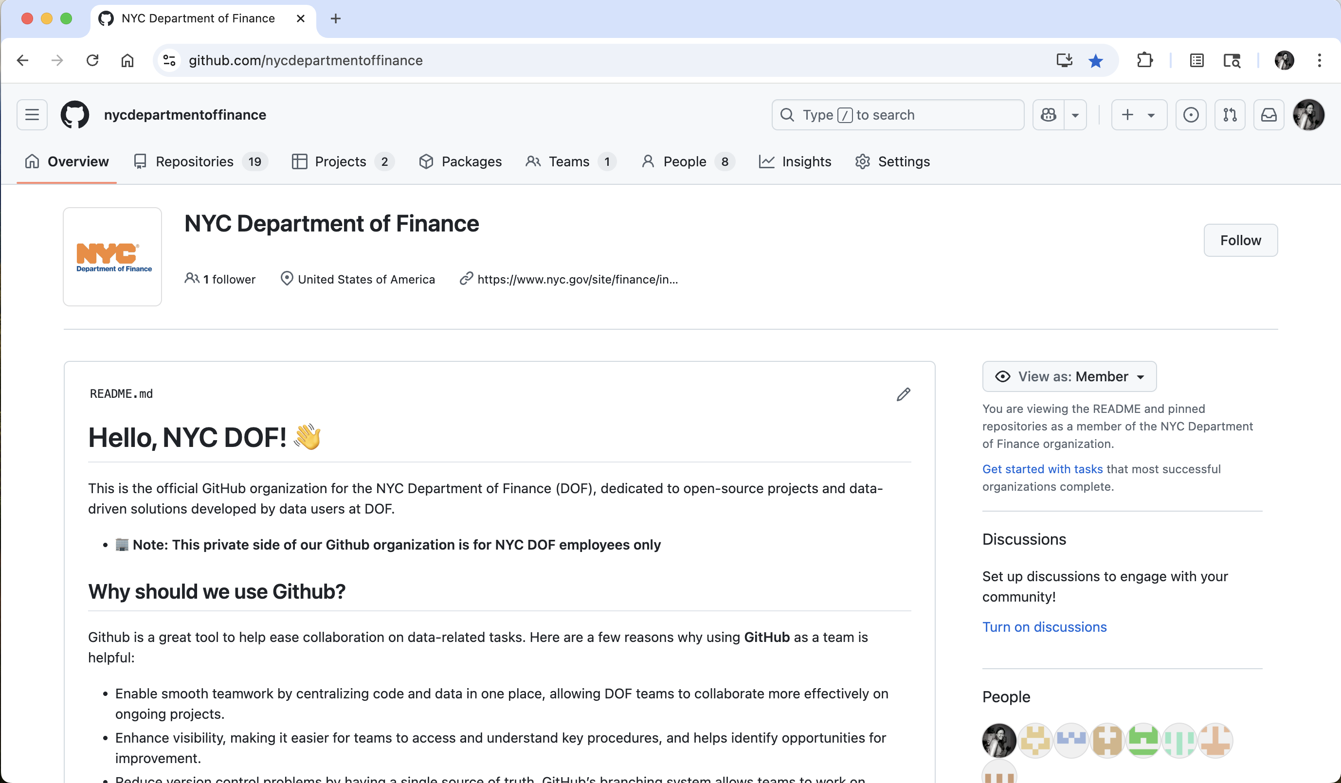
Created in accordance with current GitHub Policy

Slide 23
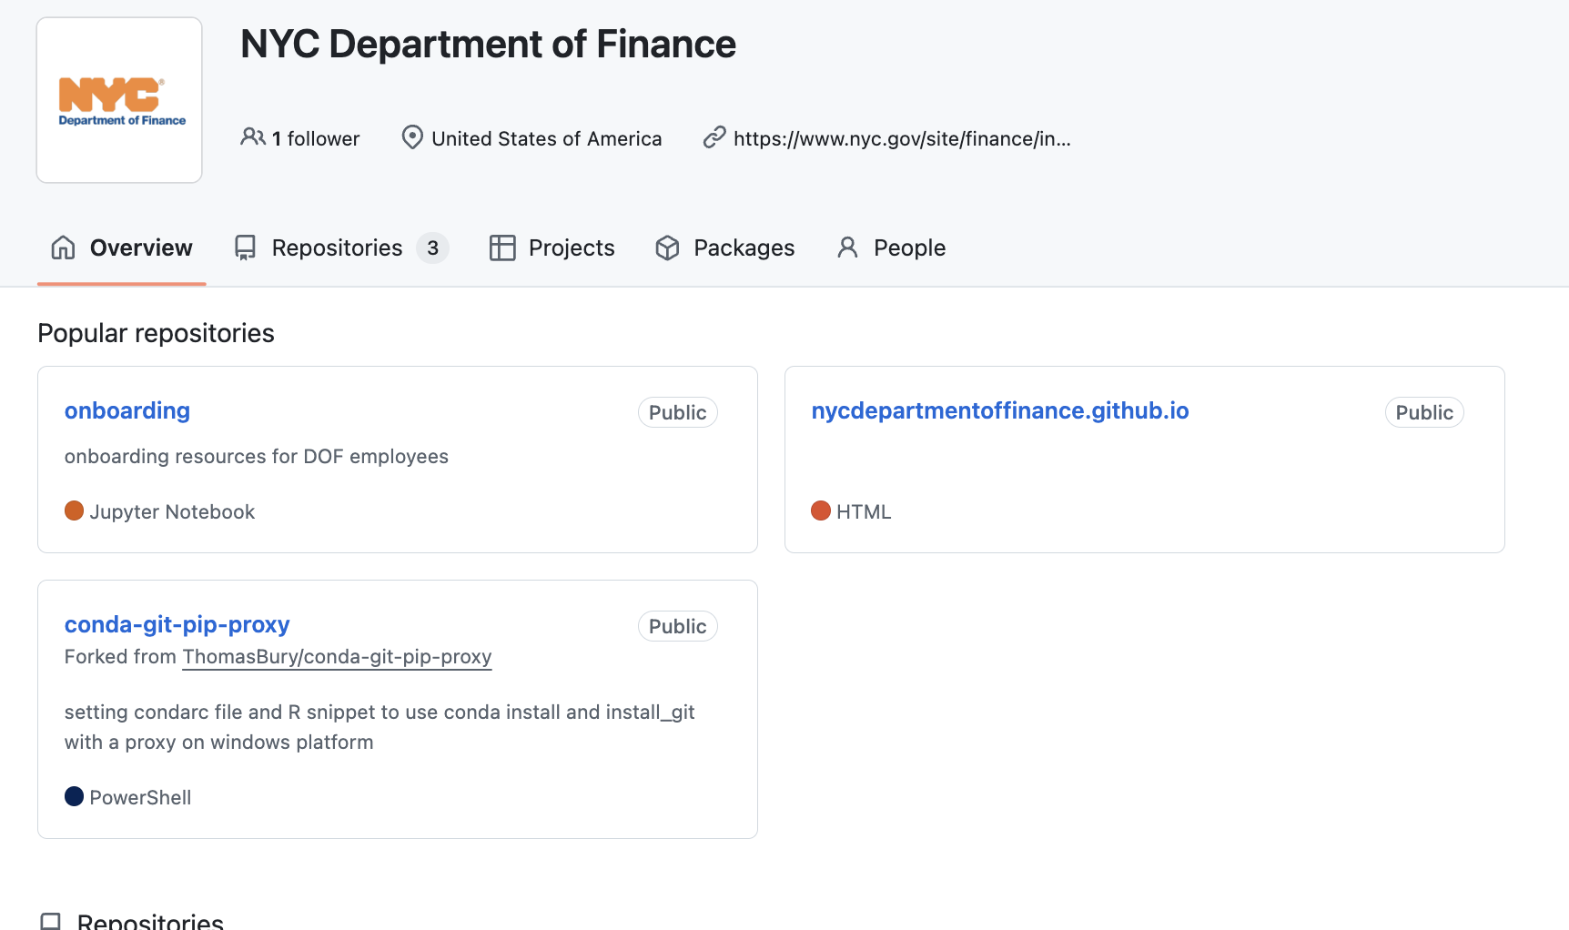
Public view
Member view (varies)
Public that we have a GitHub account
Few public folders
No visibility into our staff, procedures, etc.
Varying access to private repositories (project folders) depending on permissions
All DOF GitHub members have access to onboarding materials and how-to guides.

Slide 24
GitHub Team Structure (now)
NYC Department of Finance (GitHub Organization)
all_dof (GitHub team)
Members: 12 (as of 6/16/25)
Default access to onboarding materials, org-wide information/repositories
property_modeling (GitHub team)
Members: 8 (as of 6/16/25)
“Child” team of the all_dof parent team
Access can be granted to private repositories to the whole team (as staff come/go these permissions are easy to grant/change)
Repository access can be shared across teams or stay within one team

Slide 25
GitHub Team Structure with OTI’s Enterprise Account (~August 2025)
OTI GitHub Enterprise Account
Hosts Agency GitHub Organizations, maintains default security protocol and procedures
NYC Department of Finance (GitHub Organization)
all_dof (GitHub team)
Members: 12 (as of 6/16/25)
Default access to onboarding materials, org-wide information/repositories
property_modeling (GitHub team)
Members: 8 (as of 6/16/25)
“Child” team of the all_dof parent team

Slide 26
Use cases for GitHub at DOF
Benefits for data science teams:
Host internal/external documentation for onboarding materials
Create homes for all project related materials as the ground truth, where everyone can access/update them
Allow for easier code review and internal collaboration, to minimize reliance on institutional knowledge to repeat tasks
Create packages for internal use, to streamline data pipelines/repetitive tasks
Use git actions for additional compute power
Collaborate with other teams/organizations on projects
Benefits for other DOF teams:
Build and host interactive maps and dashboards to display information in an intuitive way, completely free
Use it as a project management tool to track progress on team goals/work
Walk through:
https://github.com/orgs/nycdepartmentoffinance/repositories

Slide 27
Existing use case #1: Detailed exploration of model performance
https://nycdepartmentoffinance.github.io/models/coop_sales_model.html#maps

Slide 28
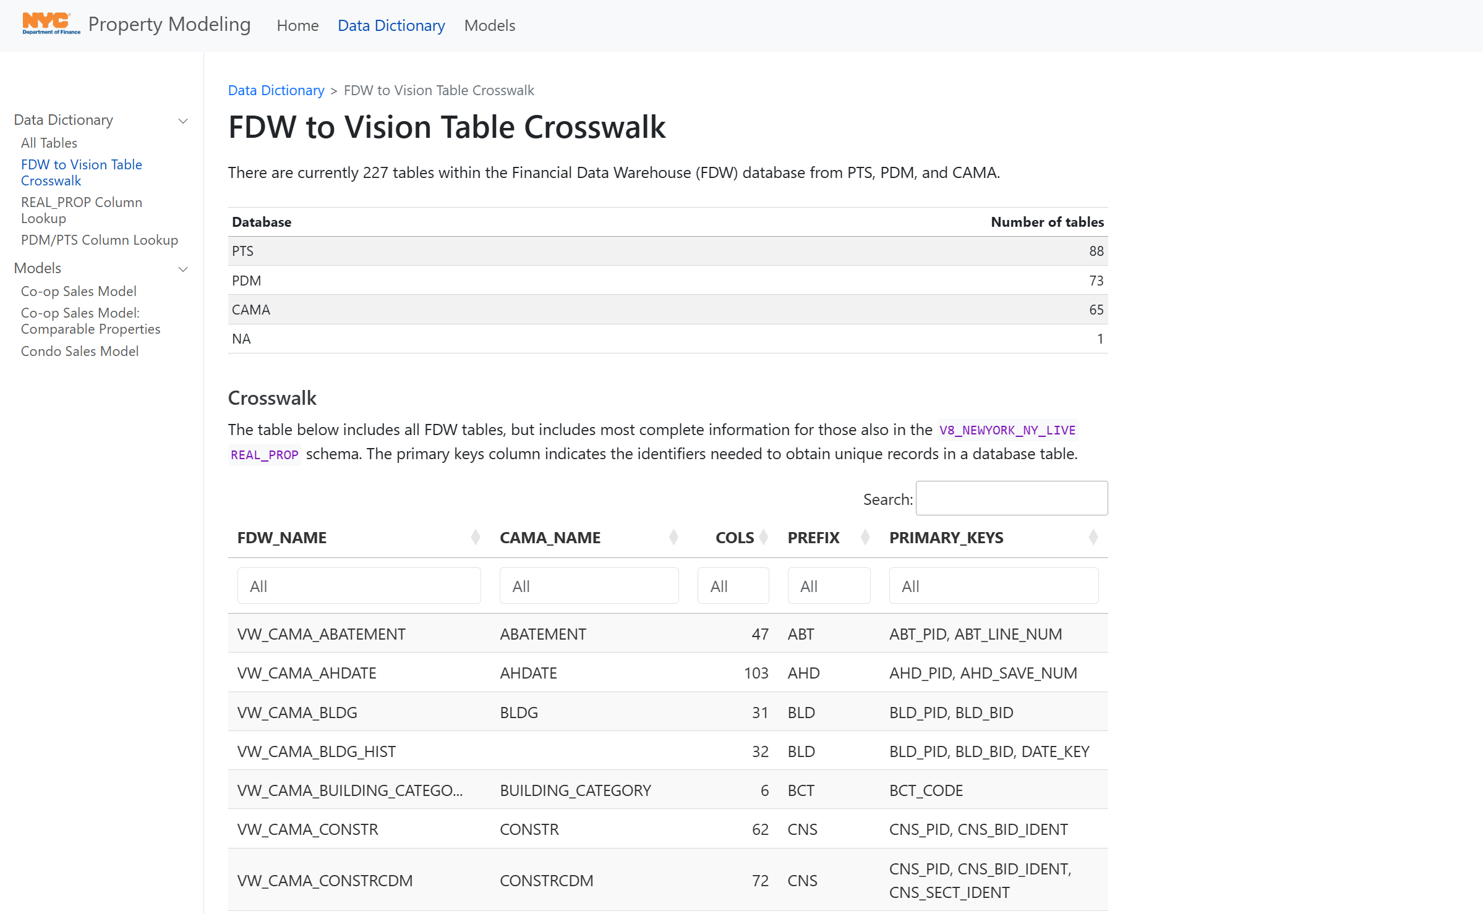
Existing use case #2: Interactive data dictionary for DOF databases
https://nycdepartmentoffinance.github.io/data_dictionary/fdw_crosswalk.html

Slide 29
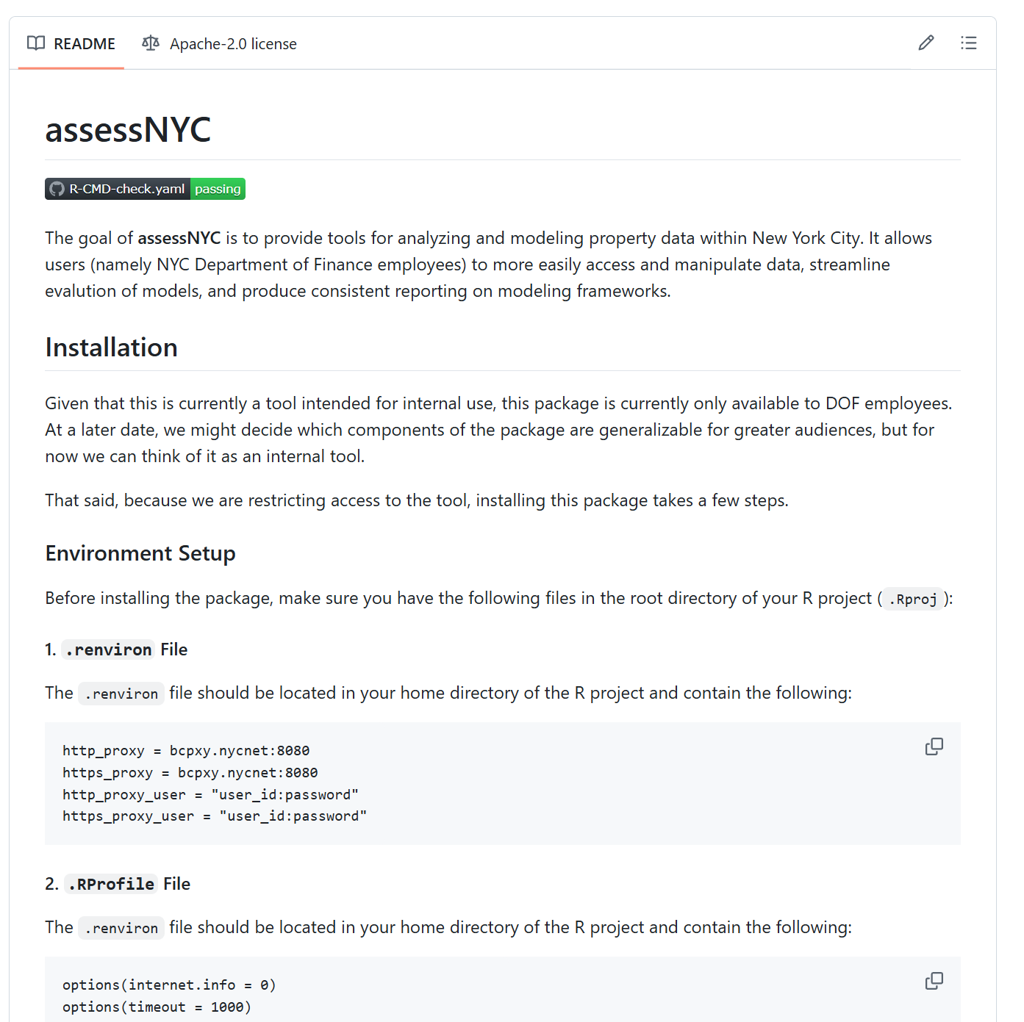
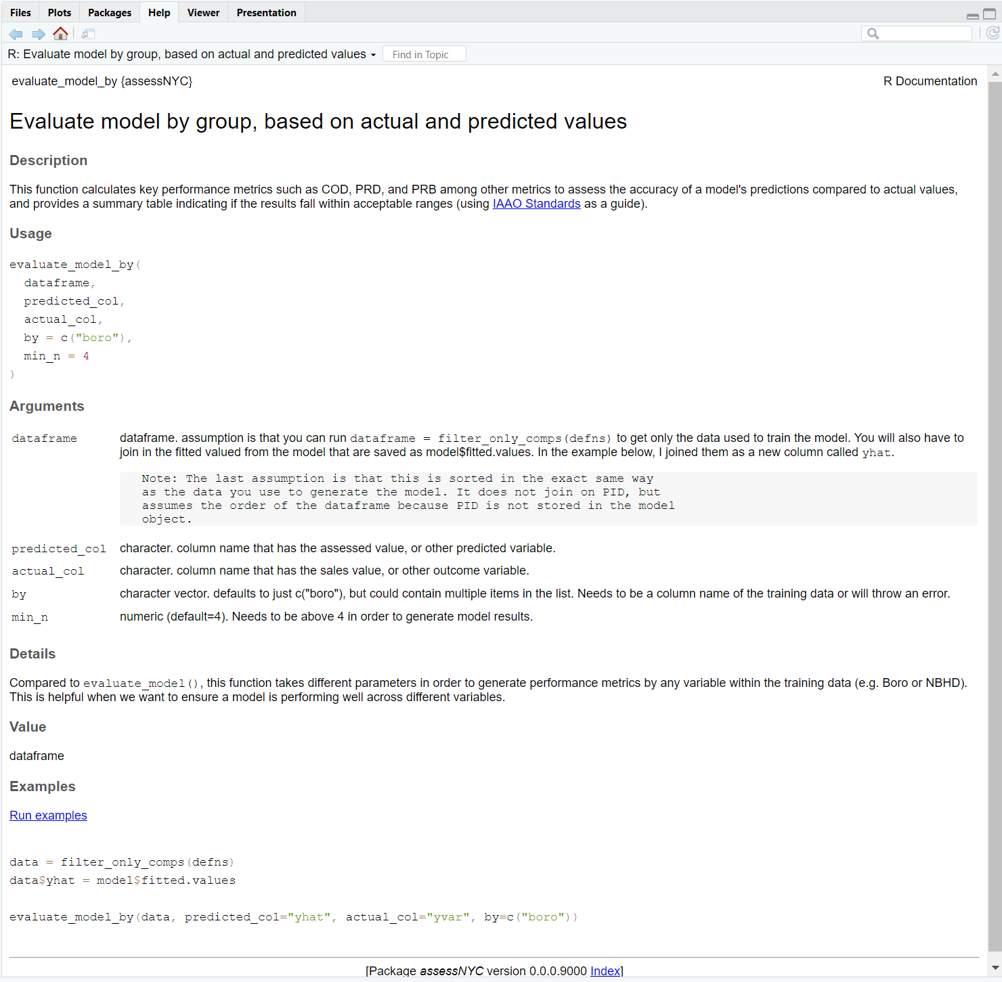
Existing use case #3: Internal package for modeling tasks
assessNYC R package
evaluate_model_by() function within package
https://github.com/nycdepartmentoffinance/assessNYC

Slide 30
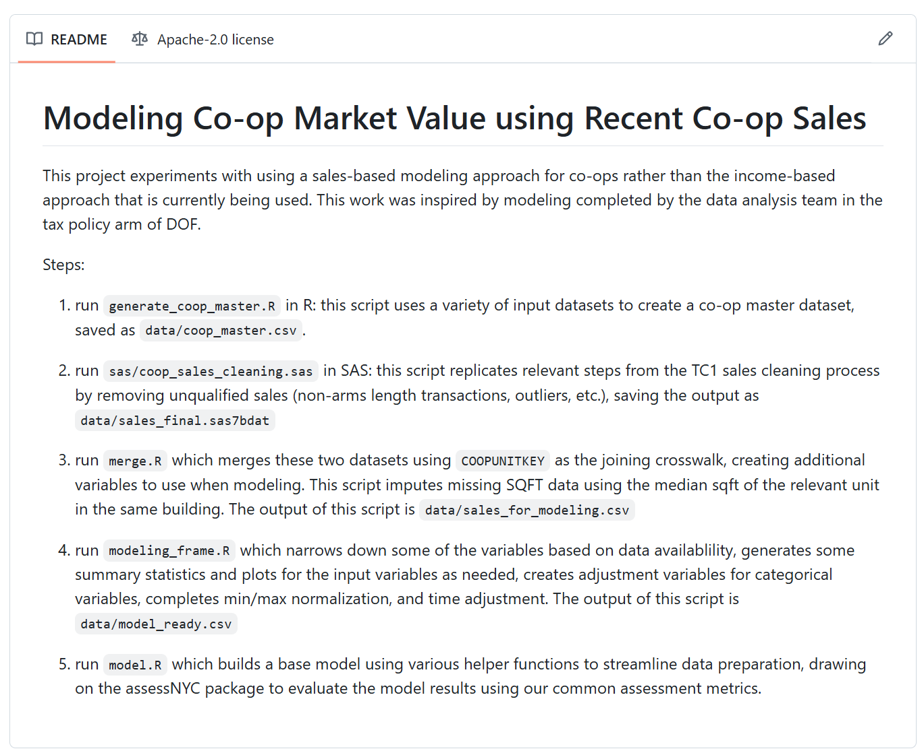
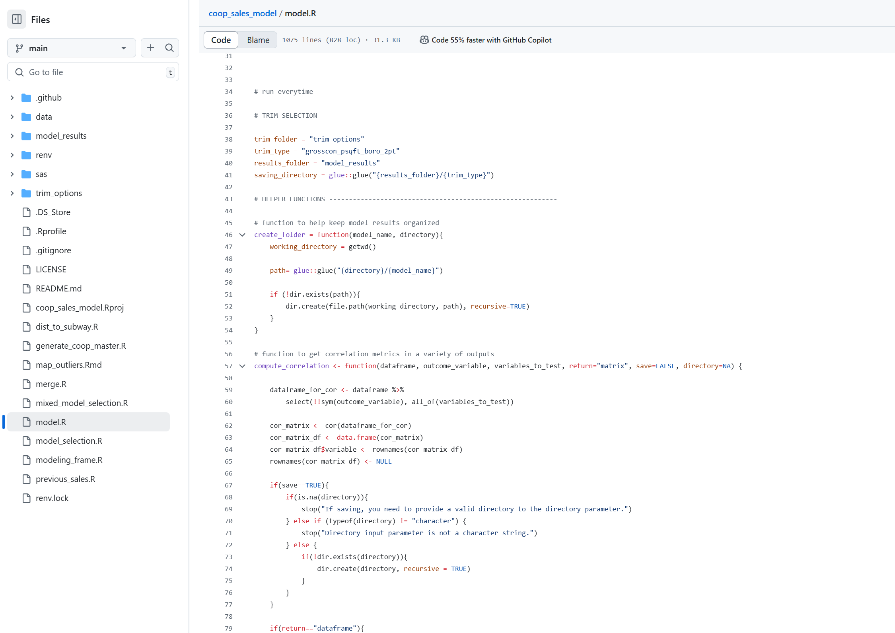
Existing use case #4: Documenting existing modeling pipeline
Documentation
Code

Slide 31
Why this matters at

Slide 32
Benefits to DOF for using git/GitHub for version control/data storage
Streamline onboarding for new hires in data-related roles where all set up and guidance on how to get started live in one place (re: proxy server)
Reduce reliance on institutional knowledge by improving documentation and replicability so that work can more easily flow between data analysts and we can decrease the amount of onboarding time needed to understand the system before new staff can get involved in more complex tasks.
Open more avenues for collaboration between analysts on the same team or across teams, allowing more insight into other teams work
Increase stability of data pipelines/products by using version control. If something breaks or is not working as it is intended, it takes 2 clicks to revert changes reliably.
Add flexibility to how analysts can work, if remote connection is unreliable or slow
Attract/retain data science talent for programmers that are interested in active collaboration on data science products.
Using GitHub is the baseline expectation of data science work outside of local government. By using this tool, we can increase the credibility of our data science work and be able to attract more talent to DOF.

Slide 33
Benefits to DOF for using git/GitHub for building tools/maps
Free and flexible. We don’t need to think about what we want and purchase tons of licenses to get access to a tool – we have the flexibility to design and implement the specific types of tools we need (e.g. the comparable property map)
Reliant on open-source tools, which often have more documentation and are easier to learn for new users/employees
Flexible across programming languages so that people can code in whatever language is most native to them or depending on what language is best for the tool we are developing
Easy to update/maintain. If we can save code based on how something is built (a recipe to re-make it), then it is much easier to replicate or change than if we built something in a point and click environment (e.g. ArcGIS)

Slide 34
Costs
Right now, everything is free.
This means we can add unlimited members to our DOF GitHub Organization.
There is no limit for storage or number of private project folders that we can create within our existing free account.
There is currently a file size limit (50 MB) for each individual file that can be uploaded, but that is rarely a limitation for our day to day work.
When we join the OTI Enterprise account, we will have access to even more features that will be at no cost to DOF.
Security precautions (e.g. making sure that passwords or any PPI data are not added to private/public repositories)
More data storage (higher file size limit) and compute power

Slide 35
Potential Concerns

Slide 36
Data Security: It is less secure than just using the G Drive.
Problem: We have less control over the data security of our work when it is not on our servers or in our system
There are security risks of users not familiar with the tool to post sensitive data, passwords, database credentials, etc.
Solution: Being under OTI’s Enterprise account will automatically ensure our protocol are in line with their expectations and guardrails.
We can keep scripts and non-sensitive data on GitHub, but cannot save any sensitive raw data on GitHub
We can set up procedures that will check for sensitive data, passwords, and credentials before information is uploaded to project folders to maintain data security.

Slide 37
Complexity: It is complicated and hard to learn.
Problem: It is hard to learn and technically difficult. It does take a little while to get the hang of it.
New users may have a steep learning curve to get up to speed on how to work in this new kind of way.
Solution: We can offer more training (happy to do this!) on both git on the command line and GitHub Desktop for users interested in different approaches.
New users will only need to use 5 commands on the command line or can use the GitHub Desktop app that has a point and click interface.
OTI is planning on having a GitHub track at their two-day conference in October that we can promote for DOF staff to attend.

Slide 38
Commitment: Re-working our processes will take time and effort.
Problem: It will take a lot of time and energy to transition our current system into one that is version controlled, organized, and intuitive.
There will need to be commitment and buy-in from both managers of data science teams as well as individual contributors to see the benefits of why this new system is worth the work.
Solution: The benefits of this new system are vast and varied. We need to be able to communicate the right benefits to the right stakeholders.
In the long term, moving to this sort of system will save time on repetitive tasks, sped up the onboarding process, and allow data practitioners to be more productive more quickly.
If we make these skills a priority for new hires, we can start to shift the culture towards using these systems as the default.

Slide 39
What now?

Slide 40
Proposed next steps
Prioritize a transition to moving ongoing/annual work into GitHub: Help support teams to move their existing work into a version-controlled environment and allow for more team collaboration and code review.
Offer ongoing git/GitHub training: We can offer monthly trainings or office hours for staff starting this process in order to support this shift and create more active dialogue about this work.
Attract new talent with these skills: List this tool on all new hire job descriptions for data science//adjacent teams. As we lose staff with older skills, we can hire staff with skills that reflect industry standards.
Amp up the existing data science forum to be a space for more informal collaboration and dialogue on these tools (office hours, brainstorm sessions, etc.).

Slide 41
Questions?

Slide 42
Appendix

Slide 43
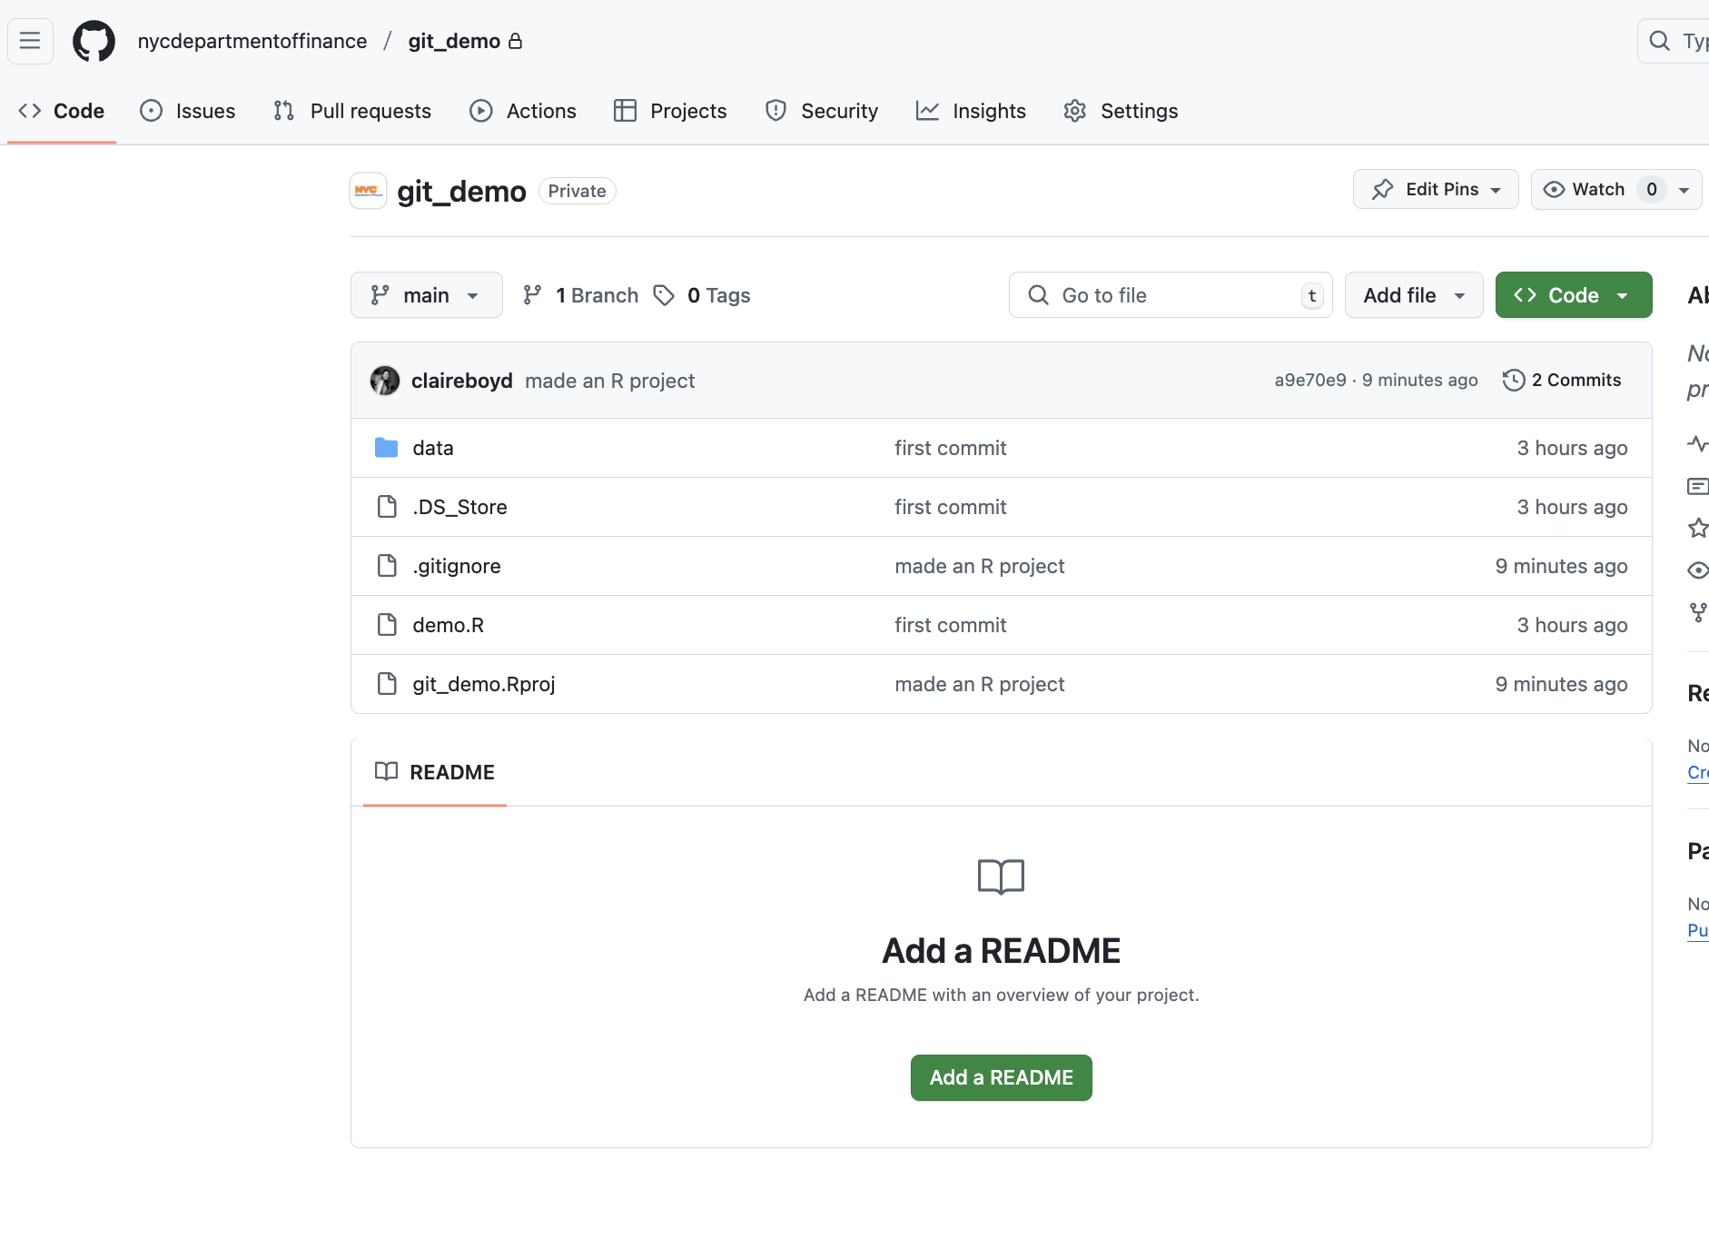
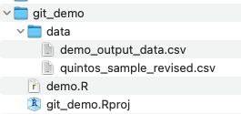
GitHub
Local Machine
git

Slide 44
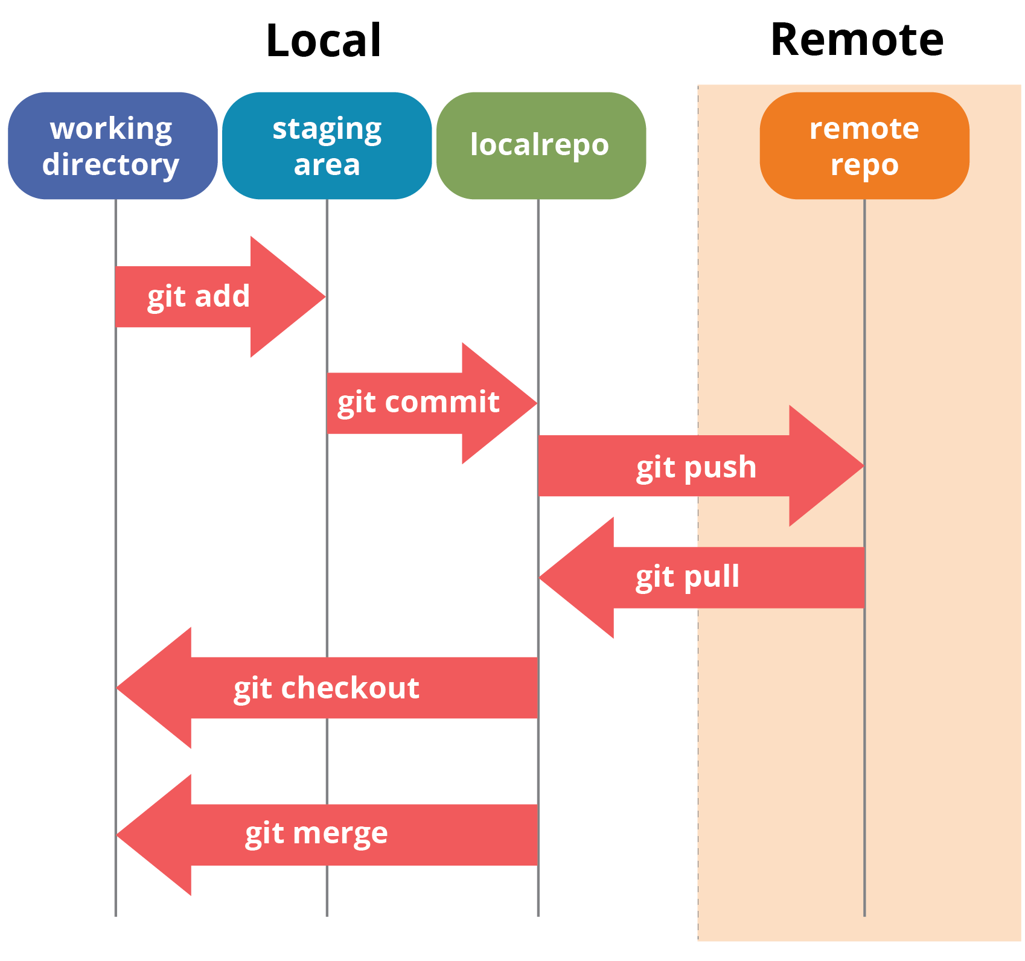
What have we done so far?
We initialized an existing folder on our computer as a git repository (a folder that git tracks the changes of)
We checked the status of the folder (what files have changed or been added/deleted)
We added the contents of that folder to our “staging” area
We committed the contents of the “staging” area to git
We checked the status of the folder again and saw that there were no new changes since our last commit.
We looked at the log and saw that our commit was saved with the message.

Slide 45
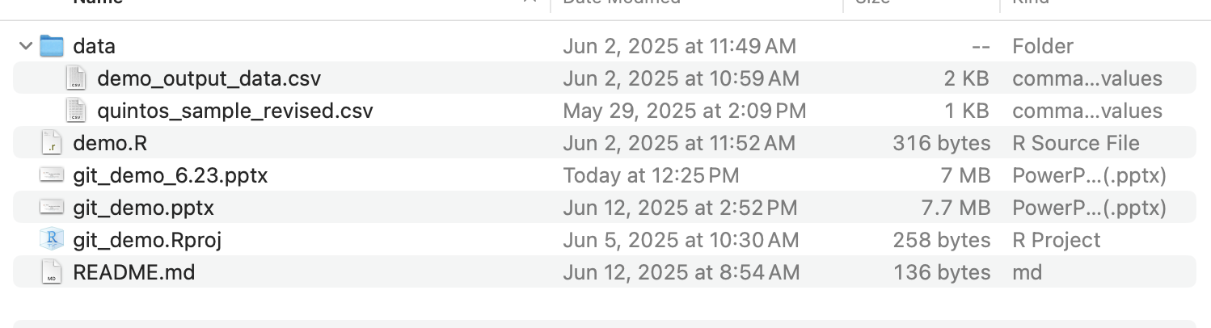
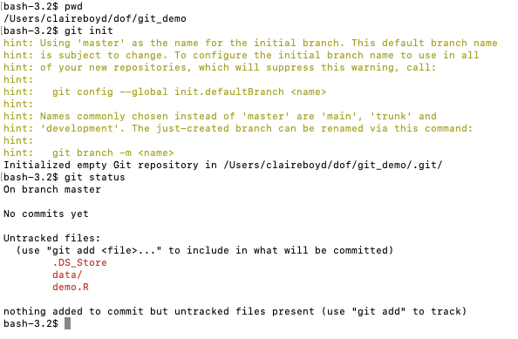
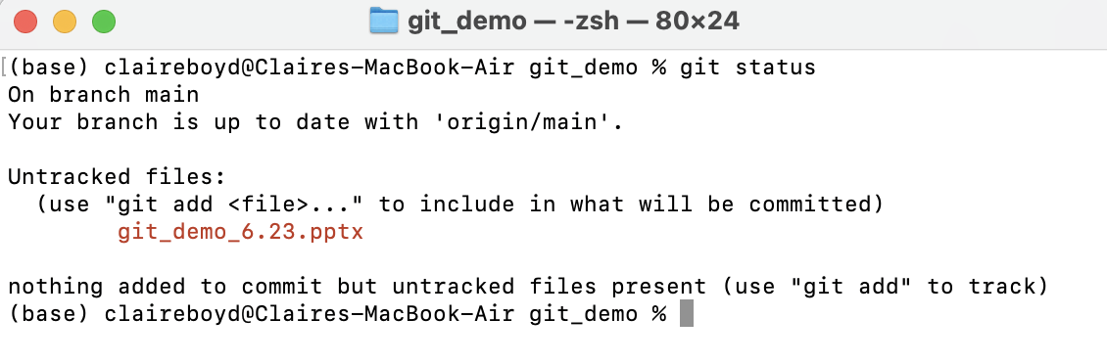
How do you save these commits (“snapshots”)?
Folder on my local machine
In a Terminal/Command Prompt
Step 1: Initialize a git repository (git init)
Steps
Ask git to track changes in the folder (git init)
Add “untracked” contents of the folder to be saved into a commit (git add [FILE_NAME])
Create a snapshot of the added files (git commit)
Check the status of the folder (git status) or the log of previous commits (git log)

Slide 46
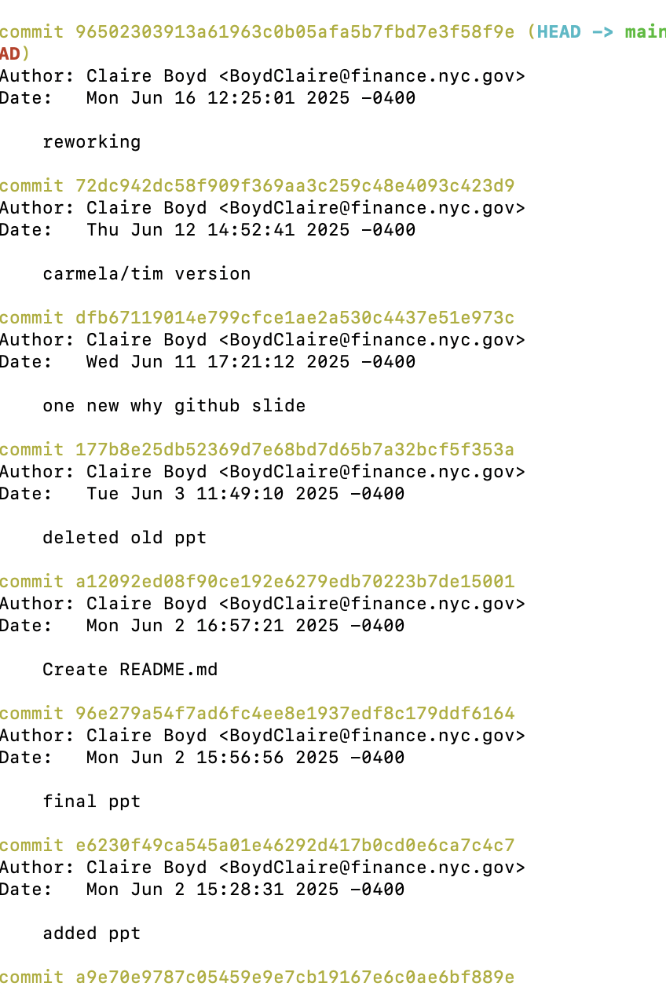
How do you save these commits (“snapshots”)?

Slide 47
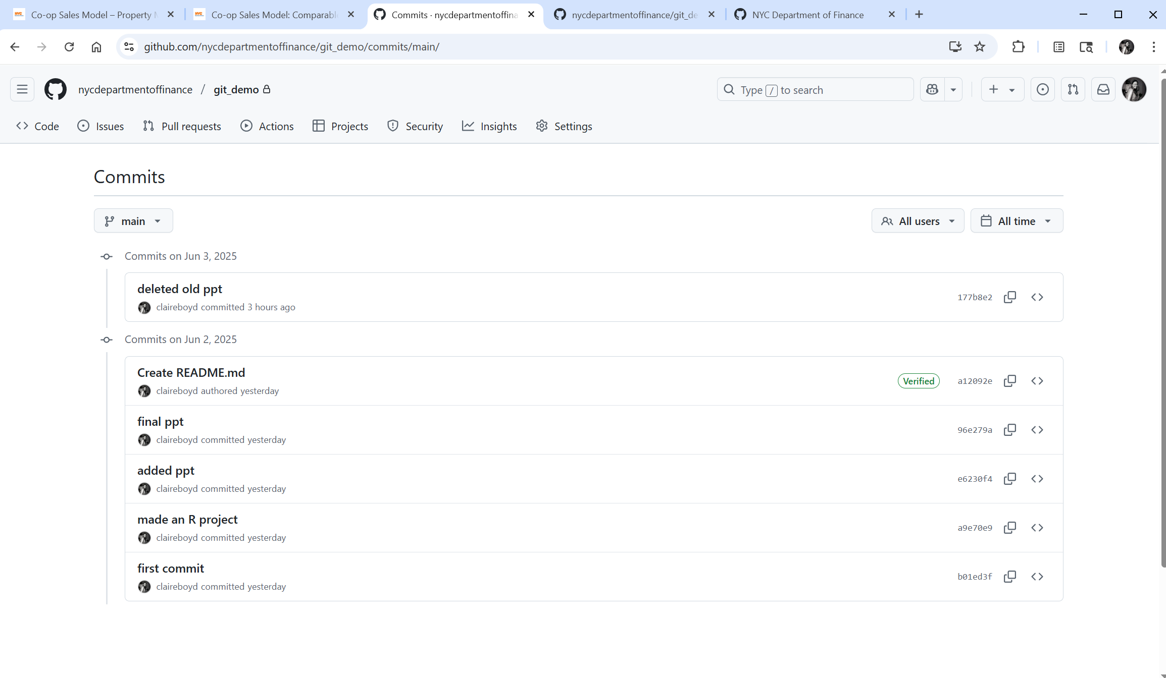
Working alone
Collaborating with others

